Slide 1

India Power Consumption Analytics Dashboard
ALAN BIJU MATHEW
DATA SCIENCE
TECHOLAS TECHNOLOGIES

Slide 2
PROJECT INTRODUCTION
This project analyzes electricity consumption across India using Power BI.
The dashboard provides interactive insights into power usage by:
Region
State
Day
Month
The aim is to convert raw data into meaningful visual insights.

Slide 3
OBJECTIVES
Analyze India's power consumption
Compare state-wise usage
Identify highest & lowest consumption
Study monthly trend
Study daily trend
Create interactive dashboard

Slide 4
Dataset Description
The dataset contains:
Region
State
Day
Month
Power Consumption
Average Usage
Minimum Usage
Maximum Usage
This data is used to build analytics dashboard

Slide 5
Tools Used
Power BI Desktop
Excel / CSV Dataset
Data Cleaning
Data Modeling
DAX Measures
Data Visualization
Data Preprocessing
Check null values
Name correction
Created calculated measures

Slide 6
DASHBOARD ANALYSIS
KPI Overview The top KPI cards provide a quick summary of the dataset including total regions, states, total consumption, average usage, minimum usage, and maximum usage. These metrics help understand overall electricity consumption.
Daily & Monthly Consumption The line chart shows daily power usage trends and identifies fluctuations across days. The monthly bar chart compares electricity consumption across different months and highlights peak demand periods.
State & Region Analysis The top states chart identifies high electricity consuming states such as Maharashtra, Gujarat, and Tamil Nadu. The region-wise donut chart compares consumption across West, North, South, East, and Northeast regions.
Map Visualization The map visual displays state-wise power consumption geographically across India, helping identify location-based demand.

Slide 7
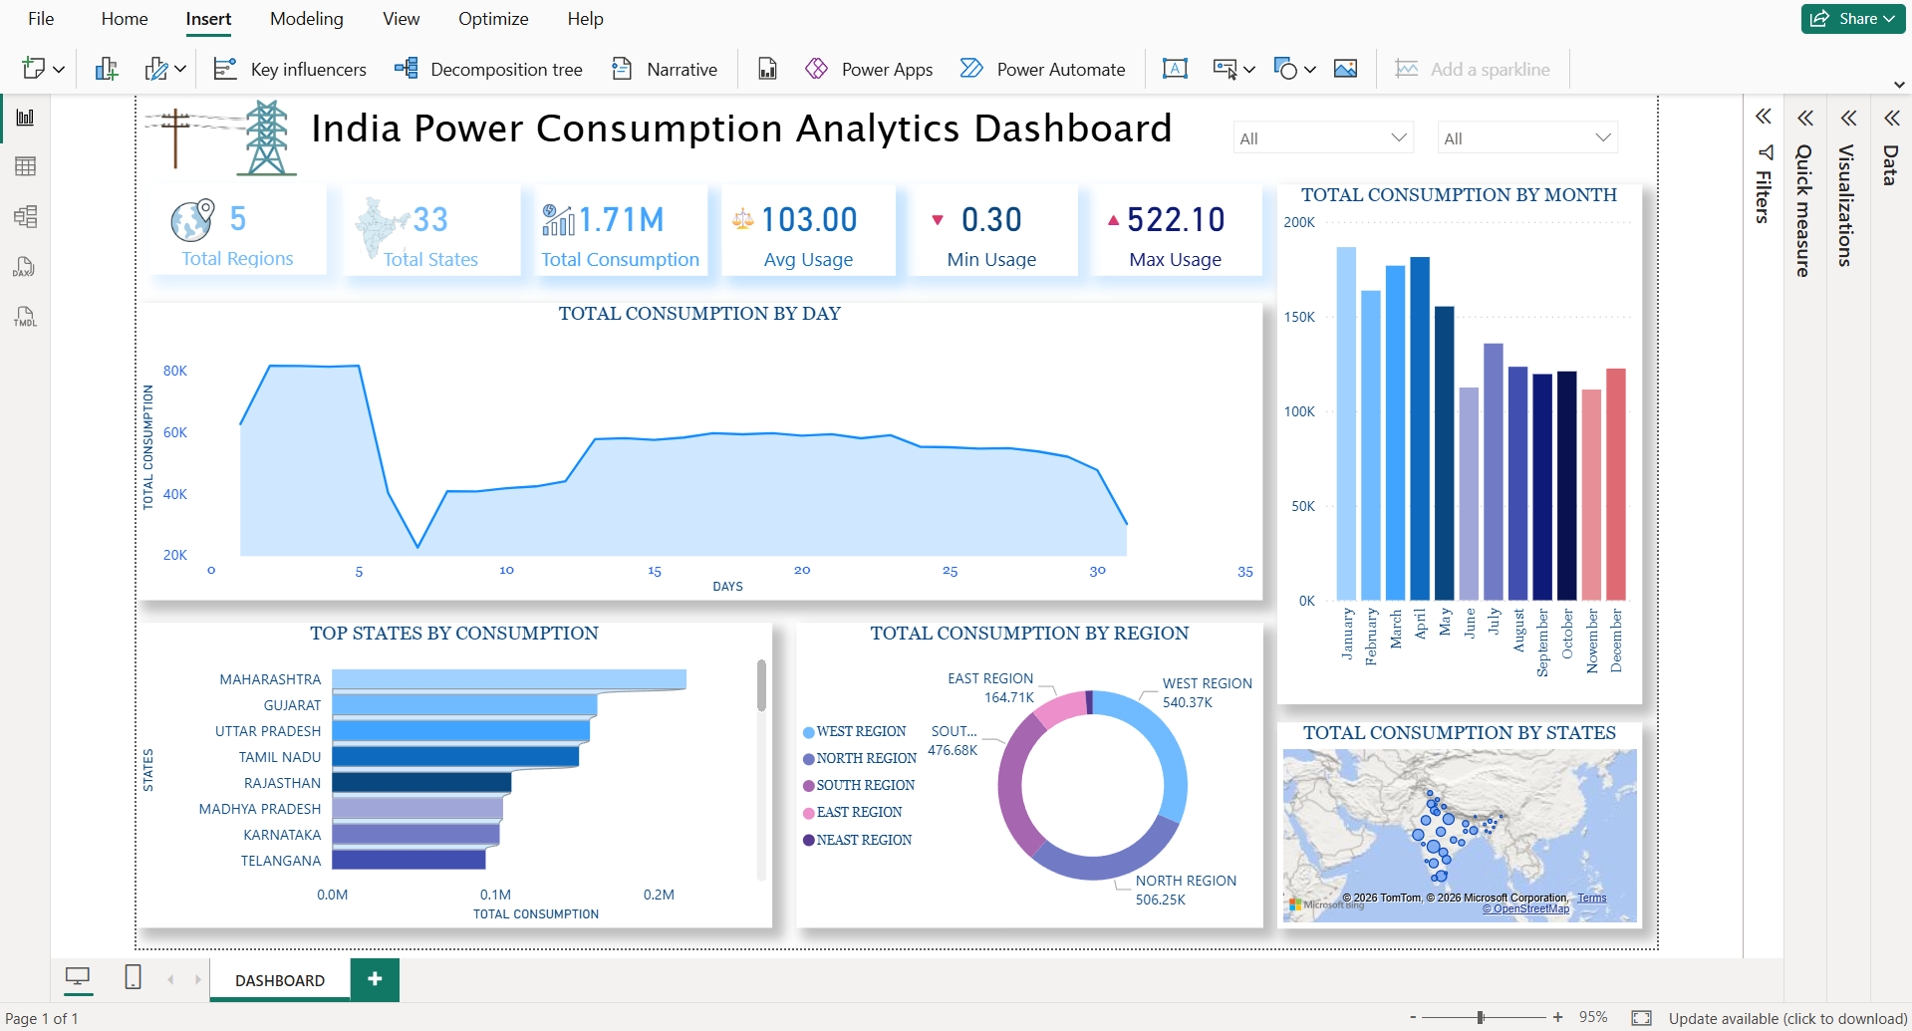

Slide 8
KEY INSIGHTS & PROJECT BENEFITS
Key Insights
West region has the highest power consumption
Maharashtra consumes the most electricity
Daily power usage shows noticeable fluctuations
Monthly consumption peaks in early months
Northeast region has the lowest usage
Project Benefits
Helps in effective power planning
Identifies high demand areas
Improves energy distribution decisions
Supports government policy planning
Useful for business energy forecasting

Slide 9
CONCLUSION
This dashboard provides a complete analysis of India's power consumption. Using Power BI, raw data is transformed into meaningful insights. This helps decision-making and energy planning.

Slide 10
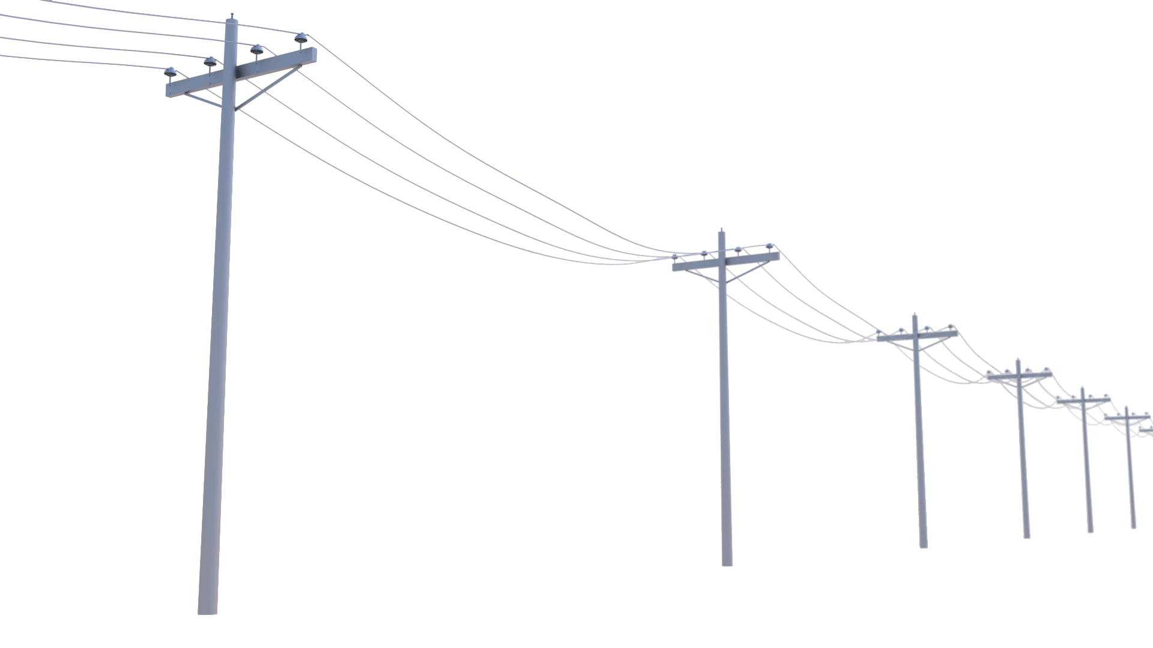
THANK YOU

